Slide 2
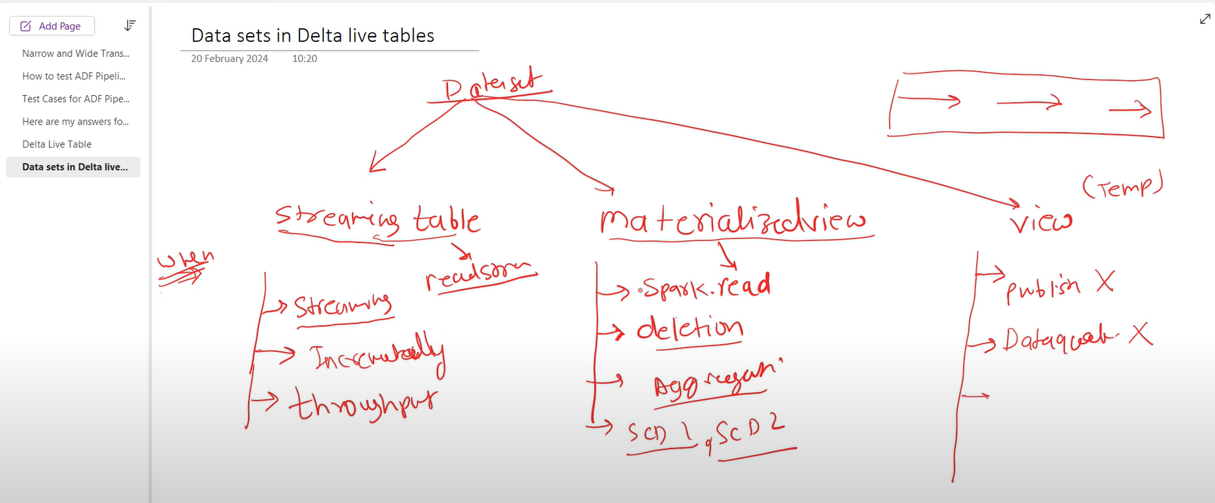

Slide 3
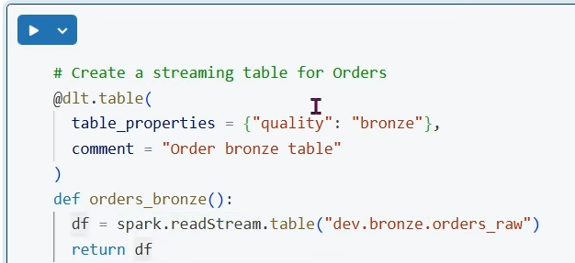
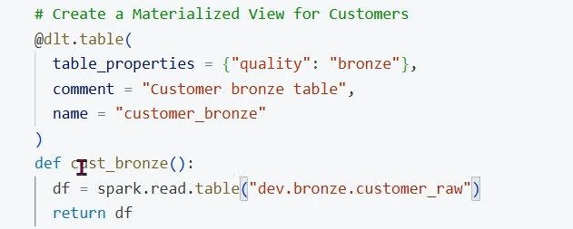
Streaming delta live tbl

Slide 4
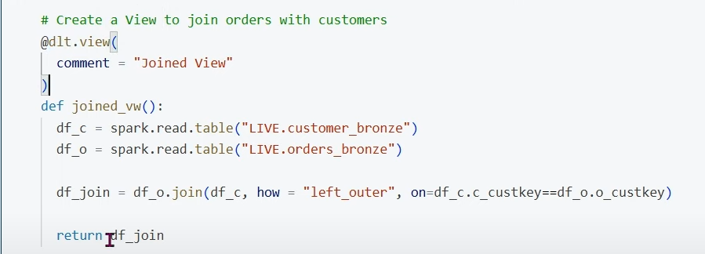

Slide 5
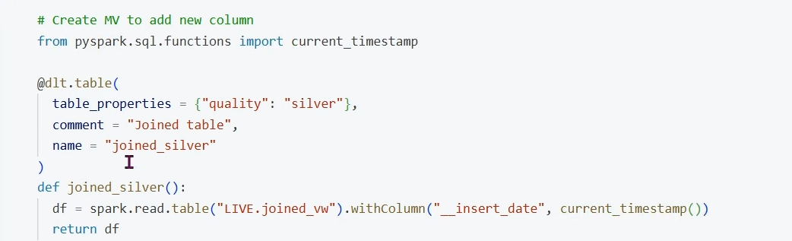

Slide 6
Lakeflow Connect

Slide 7
Lakeflow Connect offers simple and efficient connectors to ingest data from local files, popular enterprise applications, databases, cloud storage, message buses, and more.

Slide 8
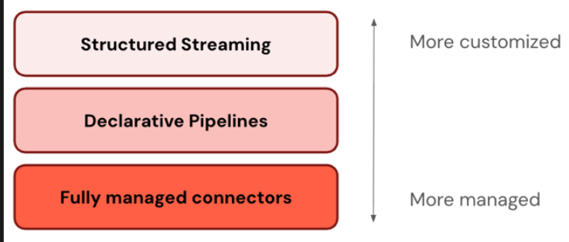
Flexible service models

Slide 9
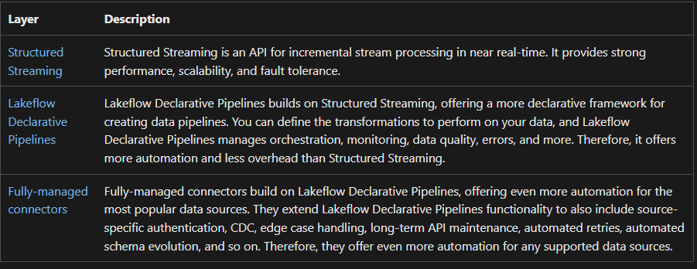

Slide 10
Managed connectors
Supported connectors include:
Google Analytics
Salesforce
ServiceNow
SharePoint
SQL Server
Workday
Supported interfaces include:
Databricks UI
Databricks Asset Bundles
Databricks APIs
Databricks SDKs
Databricks CLI

Slide 11
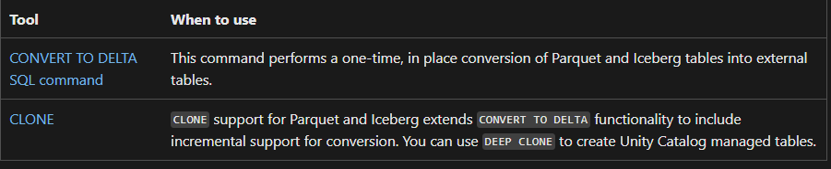
Migrate data to Delta Lake

Slide 12
Lakeflow Declarative Pipelines

Slide 13
Lakeflow Declarative Pipelines is a framework for creating batch and streaming data pipelines in SQL and Python.
Common use cases for Lakeflow Declarative Pipelines include data ingestion from sources such as cloud storage (such as Amazon S3, Azure ADLS Gen2, and Google Cloud Storage) and message buses (such as Apache Kafka, Amazon Kinesis, Google Pub/Sub, Azure EventHub, and Apache Pulsar), and incremental batch and streaming transformations.

Slide 14
What are the benefits of Lakeflow Declarative Pipelines?
Automatic orchestration: Lakeflow Declarative Pipelines orchestrate processing steps (called "flows") automatically to ensure the correct order of execution and the maximum level of parallelism for optimal performance. Additionally, Lakeflow Declarative Pipelines automatically and efficiently retry transient failures. The retry process begins with the most granular and cost-effective unit: the Spark task. If the task-level retry fails, Lakeflow Declarative Pipelines proceeds to retry the flow, and then finally the entire pipeline if necessary.
Declarative processing: Lakeflow Declarative Pipelines provides declarative functions that can reduce hundreds or even thousands lines of manual Spark and Structured Streaming code to only a few lines. The Lakeflow Declarative Pipelines AUTO CDC API simplifies processing of Change Data Capture (CDC) events with support for both SCD Type 1 and SCD Type 2. It eliminates the need for manual code to handle out-of-order events, and it does not require an understanding of streaming semantics or concepts like watermarks.
Incremental processing: Lakeflow Declarative Pipelines provides an incremental processing engine for materialized views. To use it, you write your transformation logic with batch semantics, and the engine will only process new data and changes in the data sources whenever possible. Incremental processing reduces inefficient reprocessing when new data or changes occur in the sources and eliminates the need for manual code to handle incremental processing.

Slide 15
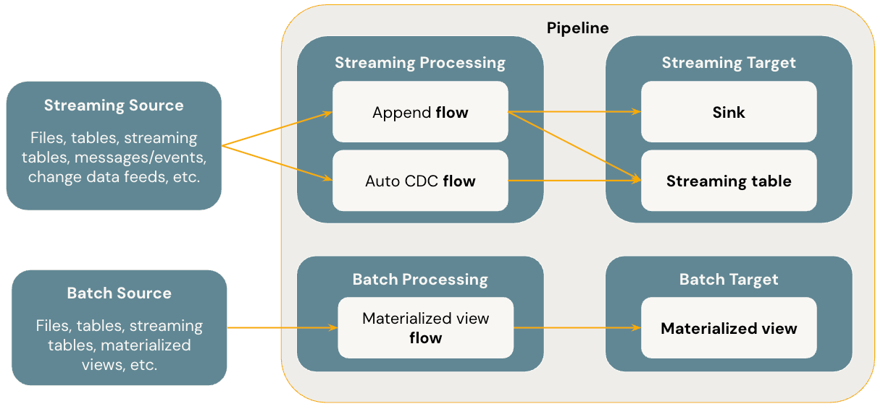

Slide 16
Flows
A flow is the foundational data processing concept in Lakeflow Declarative Pipelines which supports both streaming and batch semantics. A flow reads data from a source, applies user-defined processing logic, and writes the result into a target. Lakeflow Declarative Pipelines shares the same streaming flow type (Append, Update, Complete) as Spark Structured Streaming. (Currently, only the Append flow is exposed.) For more details, see output modes in Structured Streaming.
Lakeflow Declarative Pipelines also provides additional flow types:
AUTO CDC is a unique streaming flow in Lakeflow Declarative Pipelines that handles out of order CDC events and supports both SCD Type 1 and SCD Type 2.
Materialized View is a unique batch flow in Lakeflow Declarative Pipelines that only processes new data and changes in the source tables whenever possible.

Slide 17
Streaming tables
A streaming table is a form of Unity Catalog managed table that is also a streaming target for Lakeflow Declarative Pipelines. A streaming table can have one or more streaming flows (Append, AUTO CDC) written into it. AUTO CDC is a unique streaming flow that's only available to streaming tables. You can define streaming flows explicitly and separately from their target streaming table. You can also define streaming flows implicitly as part of a streaming table definition.

Slide 18
Materialized views
A materialized view is also a form of Unity Catalog managed table and is a batch target. A materialized view can have one or more materialized view flows written into it. Materialized views differ from streaming tables in that you always define the flows implicitly as part of the materialized view definition.

Slide 19
Sinks
A sink is a streaming target for Lakeflow Declarative Pipelines and currently supports Delta tables, Apache Kafka topics, and Azure EventHubs topics. A sink can have one or more streaming flows (Append) written into it.

Slide 20
Pipelines
A pipeline is the unit of development and execution in Lakeflow Declarative Pipelines. A pipeline can contain one or more flows, streaming tables, materialized views, and sinks. You use Lakeflow Declarative Pipelines by defining flows, streaming tables, materialized views, and sinks in your pipeline source code and then running the pipeline. While your pipeline runs, it analyzes the dependencies of your defined flows, streaming tables, materialized views, and sinks, and orchestrates their order of execution and parallelization automatically.

Slide 21
Databricks SQL for Lakeflow Declarative Pipelines
Lakeflow Declarative Pipelines provides streaming tables and materialized views as two foundational ETL capabilities in Databricks SQL.
You can use standard SQL to create and refresh streaming tables and materialized views in Databricks SQL. Streaming tables and materialized views in Databricks SQL run on the same Databricks infrastructure and have the same processing semantics as they do in Lakeflow Declarative Pipelines.
When you use streaming tables and materialized views in Databricks SQL, flows are defined implicitly as part of the streaming tables and materialized views definition.

Slide 22
Use Lakeflow Declarative Pipelines in Databricks SQL
Lakeflow Declarative Pipelines is the native way of working with data in ETL pipelines. You can define streaming tables and materialized views with simple query syntax, and Azure Databricks manages the pipelines for you. Lakeflow Declarative Pipelines functionality is also available for use outside of ETL pipelines using Databricks SQL.

Slide 23
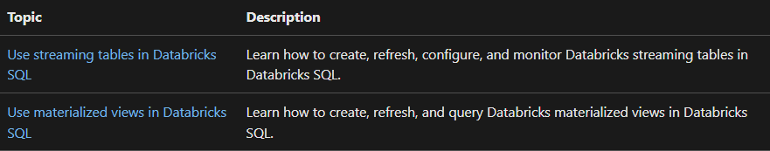

Slide 24
Use streaming tables in Databricks SQL
Databricks recommends using streaming tables to ingest data using Databricks SQL. A streaming table is a table registered to Unity Catalog with extra support for streaming or incremental data processing. A pipeline is automatically created for each streaming table. You can use streaming tables for incremental data loading from Kafka and cloud object storage.

Slide 25
Create streaming tables
A streaming table is defined by a SQL query in Databricks SQL. When you create a streaming table, the data currently in the source tables is used to build the streaming table. After that, you refresh the table, usually on a schedule, to pull in any added data in the source tables to append to the streaming table.
CREATE OR REFRESH STREAMING TABLE sales
SCHEDULE EVERY 1 hour
AS SELECT product, price FROM STREAM raw_data;

Slide 26
When you create a streaming table using the CREATE OR REFRESH STREAMING TABLE statement, the initial data refresh and population begin immediately. These operations do not consume DBSQL warehouse compute. Instead, streaming table rely on serverless Lakeflow Declarative Pipelines for both creation and refresh.
A dedicated serverless pipeline is automatically created and managed by the system for each streaming table.

Slide 27
Load files with Auto Loader
To create a streaming table from files in a volume, you use Auto Loader. Use Auto Loader with Lakeflow Declarative Pipelines for most data ingestion tasks from cloud object storage. Auto Loader and Lakeflow Declarative Pipelines are designed to incrementally and idempotently load ever-growing data as it arrives in cloud storage.
To use Auto Loader in Databricks SQL, use the read_files function.
CREATE OR REFRESH STREAMING TABLE sales
SCHEDULE EVERY 1 hour
AS SELECT * FROM STREAM read_files(
"/Volumes/my_catalog/my_schema/my_volume/path/to/data",
format => "json"
);

Slide 28
To read data from cloud storage, you can also use Auto Loader:
CREATE OR REFRESH STREAMING TABLE sales
SCHEDULE EVERY 1 hour
AS SELECT *
FROM STREAM read_files(
'abfss://myContainer@myStorageAccount.dfs.core.windows.net/analysis/*/*/*.json',
format => "json"
);

Slide 29
Streaming ingestion from other sources
By default, the read_files function reads all existing data in the source directory during table creation, and then processes newly arriving records with each refresh.
To avoid ingesting data that already exists in the source directory at the time of table creation, set the includeExistingFiles option to false
CREATE OR REFRESH STREAMING TABLE sales
SCHEDULE EVERY 1 hour
AS SELECT *
FROM STREAM read_files(
'/path/to/files',
includeExistingFiles => false
);

Slide 30
Set the runtime channel
Streaming tables created using SQL warehouses are automatically refreshed using a pipeline. Lakeflow Declarative Pipelines use the runtime in the current channel by default
Databricks recommends using the current channel for production workloads. New features are first released to the preview channel. You can set a pipeline to the preview Lakeflow Declarative Pipelines channel to test new features by specifying preview as a table property. You can specify this property when you create the table or after the table is created using an ALTER statement.

Slide 31
Create STREAMING TABLE
CREATE OR REFRESH STREAMING TABLE sales
TBLPROPERTIES ('pipelines.channel' = 'preview')
SCHEDULE EVERY 1 hour
AS SELECT *
FROM STREAM raw_data;

Slide 32
Schedule streaming table refreshes
You can configure a Databricks SQL streaming table to refresh automatically based on a defined schedule, or to trigger when upstream data is changed.
To set a schedule or trigger, do one of the following:
Configure the schedule with the SCHEDULE clause when you create the streaming table.
Configure a trigger with the TRIGGER ON UPDATE clause when you create the table.
Add or modify schedules or triggers with the ALTER STREAMING TABLE statement.

Slide 33
When you create a schedule, Azure Databricks automatically creates a new job to process the update.
To view the schedule, do one of the following:
Run the DESCRIBE EXTENDED statement from the SQL editor in the Azure Databricks UI. See DESCRIBE TABLE.
Use Catalog Explorer to view the streaming table. The schedule is listed on the Overview tab, under Refresh status. See What is Catalog Explorer?.

Slide 34
Refresh a streaming table
Refreshes can be scheduled automatically when you create the streaming table. You can also manually refresh streaming tables. Even if you have a scheduled refresh, you can call a manual refresh at any time. Refreshes are handled by the same pipeline that was automatically created along with the streaming table.
REFRESH STREAMING TABLE sales;
REFRESH STREAMING TABLE sales FULL;
Change the schedule for a streaming table
ALTER STREAMING TABLE sales
ADD SCHEDULE every 1 hour;
Track the status of a refresh
DESCRIBE TABLE EXTENDED <table-name>;

Slide 35
Control access to streaming tables
Streaming tables support rich access controls to support data-sharing while avoiding exposing potentially private data. A streaming table owner or a user with the MANAGE privilege can grant SELECT privileges to other users. Users with SELECT access to the streaming table do not need SELECT access to the tables referenced by the streaming table. This access control enables data sharing while controlling access to the underlying data.
GRANT <privilege_type> ON <st_name> TO <principal>;
The privilege_type can be:
SELECT - the user can SELECT the streaming table.
REFRESH - the user can REFRESH the streaming table. Refreshes are run using the owner's permissions.

Slide 36
CREATE MATERIALIZED VIEW st_name AS SELECT * FROM source_table;
-- Grant read-only access:
GRANT SELECT ON st_name TO read_only_user;
-- Grand read and refresh access:
GRANT SELECT ON st_name TO refresh_user;
GRANT REFRESH ON st_name TO refresh_user;

Slide 37
Revoke privileges from a streaming table
REVOKE privilege_type ON <st_name> FROM principal;
When SELECT privileges on a source table are revoked from the streaming table owner or any other user who has been granted MANAGE or SELECT privileges on the streaming table, or the source table is dropped, the streaming table owner or user granted access is still able to query the streaming table. However, the following behavior occurs:
The streaming table owner or others who have lost access to a streaming table can no longer REFRESH that streaming table, and the streaming table will become stale.
If automated with a schedule, the next scheduled REFRESH fails or is not run.
REVOKE SELECT ON st_name FROM read_only_user;

Slide 38
Permanently delete records from a streaming table
To physically delete records from the underlying storage for a streaming table with deletion vectors enabled, such as for GDPR compliance, additional steps must be taken to ensure that a VACUUM operation runs on the streaming table's data.
To physically delete records from underlying storage:
Update records or delete records from the streaming table.
Run a REORG statement against the streaming table, specifying the APPLY (PURGE) parameter. For example REORG TABLE <streaming-table-name> APPLY (PURGE);.
Wait for the streaming table's data retention period to pass. The default data retention period is seven days, but it can be configured with the delta.deletedFileRetentionDuration table property. See Configure data retention for time travel queries.
REFRESH the streaming table. See Refresh a streaming table. Within 24 hours of the REFRESH operation, Lakeflow Declarative Pipelines maintenance tasks, including the VACUUM operation which is required to ensure records are permanently deleted, are run automatically.

Slide 39
Use materialized views in Databricks SQL
What are materialized views?
In Databricks SQL, materialized views are Unity Catalog managed tables that physically store the results of a query. Unlike standard views, which compute results on demand, materialized views cache the results and update them as the underlying source tables change—either on a schedule or automatically.
Materialized views are well-suited for data processing workloads such as extract, transform, and load (ETL) processing. Materialized views provide a simple, declarative way to process data for compliance, corrections, aggregations, or general change data capture (CDC). Materialized views also enable easy-to-use transformations by cleaning, enriching, and denormalizing base tables. By pre-computing expensive or frequently used queries, Materialized views lower query latency and resource consumption.

Slide 40
The following are common use cases for materialized views:
Keeping a BI dashboard up to date with minimal end-user query latency.
Reducing complex ETL orchestration with simple SQL logic.
Building complex, layered transformations.
Any use cases that demand consistent performance with up-to-date insights.

Slide 41
Create a materialized view
Databricks SQL materialized view CREATE operations use a Databricks SQL warehouse to create and load data in the materialized view. Creating a materialized view is a synchronous operation, which means that the CREATE MATERIALIZED VIEW command blocks until the materialized view is created and the initial data load finishes.
A serverless pipeline is automatically created for every Databricks SQL materialized view. When the materialized view is refreshed Lakeflow Declarative Pipelines processes the refresh.
-- This query defines the materialized view:
CREATE OR REPLACE MATERIALIZED VIEW mv1
AS SELECT
date,
sum(sales) AS sum_of_sales
FROM
base_table1
GROUP BY
date;
ALTER MATERIALIZED VIEW sales ALTER SCHEDULE EVERY 1 day;
DROP MATERIALIZED VIEW mv1;

Slide 42
Refresh a materialized view
REFRESH MATERIALIZED VIEW mv1;
REFRESH MATERIALIZED VIEW mv1 ASYNC;

Slide 43
How are Databricks SQL materialized views refreshed?
Materialized views automatically create and use serverless Lakeflow Declarative Pipelines to process refresh operations. The refresh is managed by the pipeline and the update is monitored by the Databricks SQL warehouse used to create the materialized view. Materialized views can be updated using a pipeline that runs on a schedule. Databricks SQL created materialized views always run in triggered mode.

Slide 44
Materialized views are refreshed using one of two methods.
Incremental refresh - The system evaluates the view's query to identify changes that happened after the last update and merges only the new or modified data.
Full refresh - If an incremental refresh can't be performed, the system runs the entire query and replaces the existing data in the materialized view with the new results.
The structure of the query and the type of source data determine whether incremental refresh is supported. To support incremental refresh, source data should be stored in Delta tables, with row tracking and change data feed enabled. After you create a materialized view, you can monitor its refresh behavior to verify whether it is updated incrementally or through a full refresh.

Slide 45
Asynchronous refreshes
By default, refresh operations are performed synchronously. You can also set a refresh operation to occur asynchronously. This can be set using the refresh command with the ASYNC keyword.
Synchronous: A synchronous refresh prevents other operations from proceeding until the refresh is complete. If the result is needed for the next step, such as when sequencing refresh operations in orchestration tools like Lakeflow Jobs, use a synchronous refresh. To orchestrate materialized views with a job, use the SQL task type. See Lakeflow Jobs.
Asynchronous: An asynchronous refresh starts a background job on Lakeflow Declarative Pipelines compute when a materialized view refresh begins, allowing the command to return before the data load completes. This refresh type can save on cost because the operation doesn't necessarily hold compute capacity in the warehouse where the command is initiated. If the refresh becomes idle and no other tasks are running, the warehouse can shut down while the refresh uses other available compute. Additionally, asynchronous refreshes support starting multiple operations in parallel.

